Slide 1
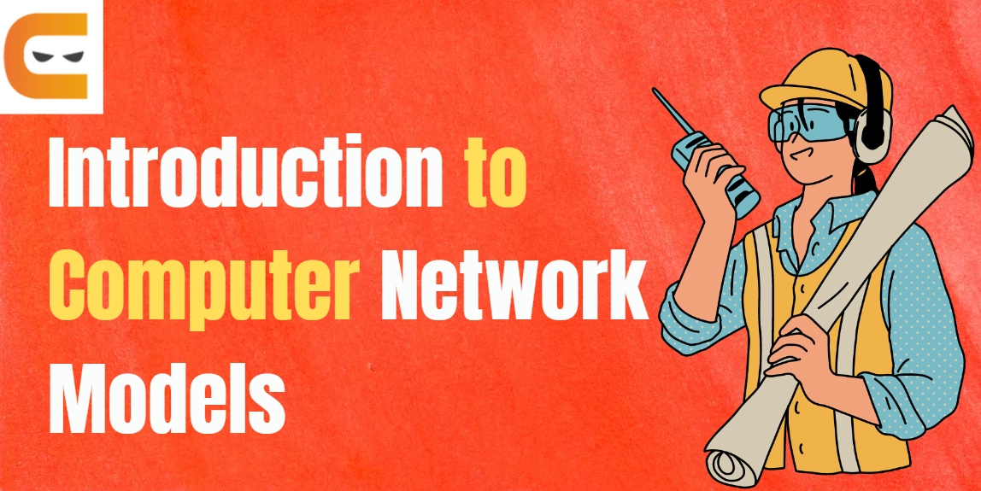
LEC -6 and 7 NETWORK MODEL –OSI and TCP/IP protocol Model.

Slide 2
What is TCP/IP Model ?
The TCP/IP model is also called Transmission Control Protocol/Internet Protocol Model. The main function of TCP/IP model is overseeing efficient and error-free transmission of data.
TCP/IP model works on a four-layered architecture model .
Transmission Control Protocol/Internet Protocol and is a suite of communication protocols used to interconnect network devices on the internet.
This model works on a four-layered architecture model in which each layer implicit the required network protocols on the data to be transmitted for efficient transmission over the network.

Slide 3
Layer Difference between both TCP/IP and OSI models.

Slide 4
Development of TCP/IP.
TCP/IP was developed by U.S. Department of Defense to connect computers within their networks and with each other across national boundaries.
The first version of TCP/IP was ARPANET (1975), which stands for Advanced Research Projects Administration Network. The name changed to TCP/IP in 1983, when it became an open standard that could be used on any network.

Slide 5
Relationship of layers and addresses in TCP/IP.

Slide 6
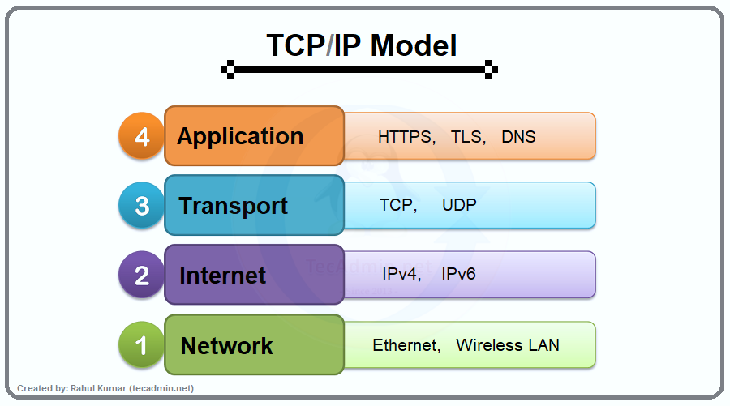
Layers in the TCP/IP Model .
In the TCP/IP model each layer performs a specific task on the data that is being transmitted over the network channel, and data moves from one layer to another .

Slide 7
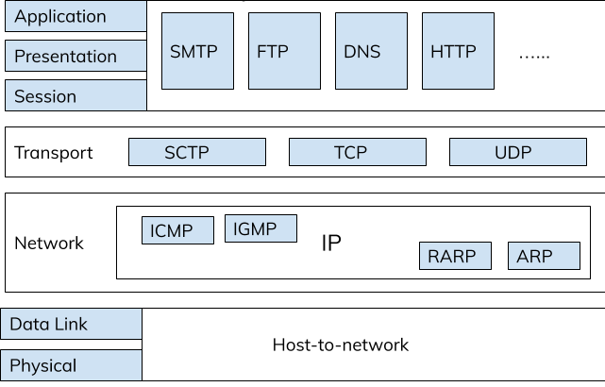
Protocols used in TCP/IP Networking Model.

Slide 8
What is TCP/IP PROTOCOL SUITE ?
The layers in the TCP/Ip protocol suite do not exactly match those in the OSI model. The original TCP/IP protocol suite was defined as having four layers : host-to network, internet, transport, and application.
However, when TCP/IP is compared to OSI, we can say that the TCP/IP protocol suite is made of five layers :physical, data link , network, transport, and application.

Slide 9
Protocols work in layers of TCP/IP Model .

Slide 10
Addresses perform in TCP/IP.
Four levels of addresses are used in an internet employing the TCP/Ip protocols :physical ,logical, port, and specific.
Physical Addresses .
Logical Addresses
Port Addresses
Specific Addresses

Slide 11
Function perform by addresses according to layers in TCP/IP.

Slide 12
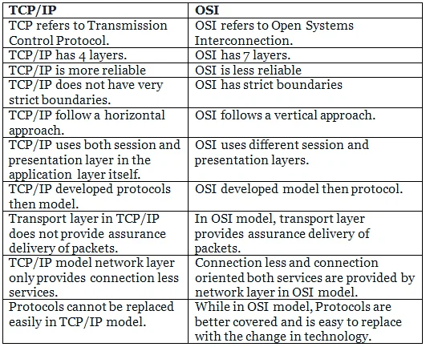
Comparison of the OSI and TCP/IP Reference Models .

Slide 13
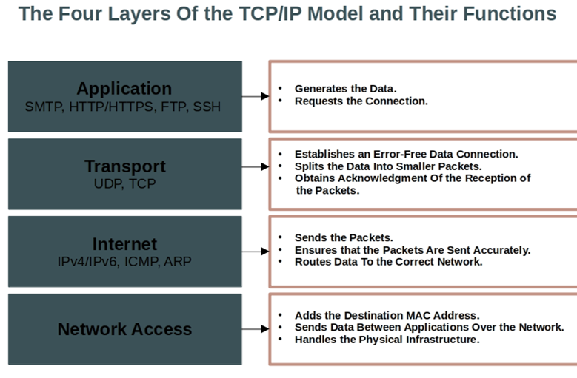
Different layers function in TCP /IP Model.

Slide 14


